Slide 1

ad.ops

Slide 2
Structure and process
of Almap’s Ad.Ops

Slide 3
About the functions
of an AdServer

Slide 4





ad.server + ad.ops
Metrics: impressions, clicks, interaction
Creative control delivery: schedule, period, quantity, priority
Segmentation: geographic, browsing
Unification: consolidated metrics of the campaign according to all vehicles
Sobreposition: cross single users with different vehicles
Monitoring: allow keep up in real-time the campaign delivery
Conversion: keep up the conversion tags
Auditory: compare your results with the results of the vehicle
Site
Requisition / Banner
AdServer
Banners Register
REASONS TO UTILIZE AN ADSERVER

Slide 5

ad.server + ad.ops
STANDARD
DISPLAY
DYNAMICS
CREATIVES
RICH
MEDIA
TRACKING PIXEL
& CLICK
Utilizes images to sell.
From the same template, allow exchange information of dynamic forms.
Allow a bigger interaction. Expansives Flutuant Formats.
Code lines accounting of impressions and clicks. Keep up the creative.
SUPPORTED FORMATS

Slide 6
ad.server + ad.ops
Adserver for advertisers | Standard Display | Dynamics Creative | Rich Media | Tracking Pixel + Click | Tracking Click
Metrics | Yes | Yes | Yes | Impressions and clicks | Clicks
Delivery Control | Yes | Yes | Yes | No | No
Segmentation | Yes | Yes | Yes | No | No
Unificacion | Yes | Yes | Yes | Yes | Yes
Overlay | Yes | Yes | Yes | Yes | Yes
Monitoring | Yes | Yes | Yes | Yes | Yes
Conversions | Yes | Yes | Yes | Yes | Yes
Auditory* | Yes | Yes | Yes | Yes | Yes
FORMAT REPORTS

Slide 7
About Ad.Ops process

Slide 8

ad.server + ad.ops
CONFIGURE ADSERVER
CREATIVE REGISTER
TECHNICAL INTERFACE WITH THE VEHICLES
DISCREPANCY SUPPORT
SEND INFORMATION
CONTROLS UNDER AND OVER
VEHICULATION CHECKING
FIELD RESPONSIBILITIES

Slide 9


ad.server + ad.ops
Real-time unification by campaign
Centralized receiving
Checking between conversion database and vehicles
Adserver patronization
Immediacy. Minor responding time to adjust in campaign
Automation
Better quality of database for better decision making
Status indicators / Error control
EFFICIENCY

Slide 10
Almap BBDO Structure

Slide 11
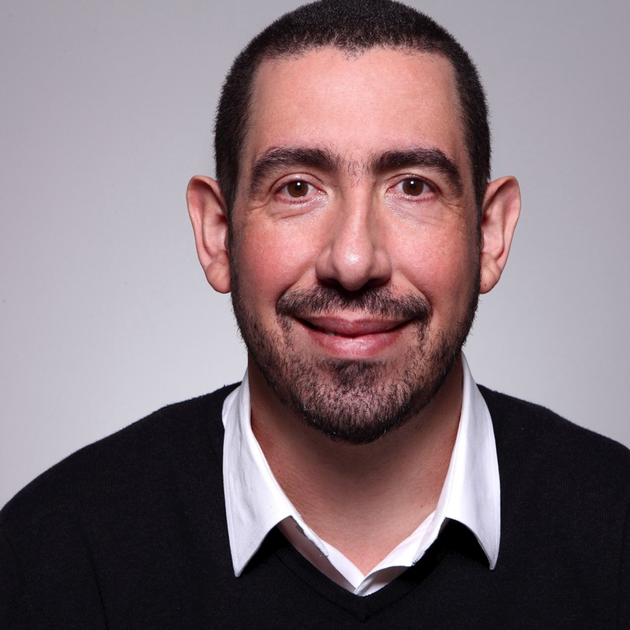
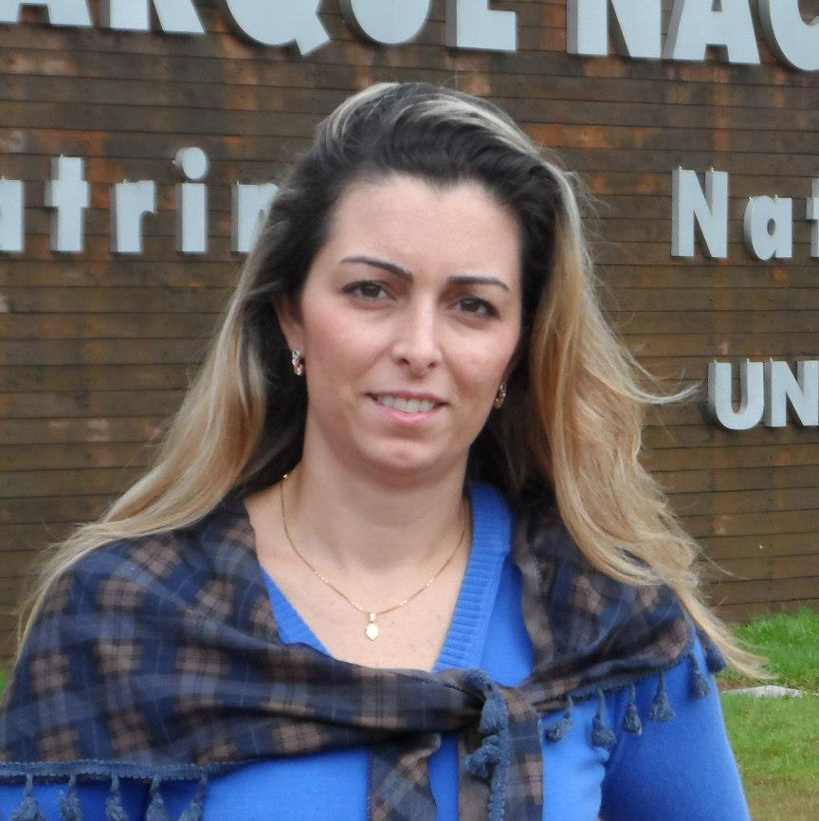


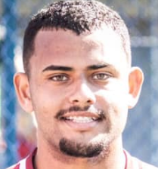







ad.server + ad.ops
PÁRIS PIEDADE
PERFORMANCE AND
DATABASE VP
SIMONE HENRIQUE
OPERATION MEDIA MANAGER
WILSON SILVA
AD.OPS SUPERVISOR
FELIPE LIMA
AD.OPS ASSISTANT
CÉSAR AUGUSTO
AD.OPS ASSISTANT
CLIENTS AND TEAM

Slide 12


ad.server + ad.ops
ad.ops is flag above the new campaign
The campaign plan is approved
ad.ops cheeks the accounting of the banners and does the control camping
media fills in ad.placement and sent to ad.ops
ad.ops send the information to the vehicles
Media mounts and send the spreadsheet of attendance production
ad.ops checks the receive creatives and input in the ad.sever and generate the tags
Attendance asks creative production to creation team
media organizes the delivery networking according to format/vehicle and send to ad.ops
attendance receives the named creatives according to production spreadsheet
PROCESS

Slide 13






ad.server + ad.ops
Real-time unification by campaign
Checking between conversion database and vehicles
Immediacy. Minor responding time to adjust in campaign
Better quality of database for better decision making
The integrated vision between the media, ad.ops, and BI to set better analyses
Reduced SLA (2days) after received the material inside the patron
BENIFTS ALMAP BBDO AND OBSERVATIONS

Slide 14




ad.server + ad.ops
ad.server
ad.ops
CPM
CPV
RICH MEDIA
CPC
R$ 0,04
R$ 0,60
R$ 0,91
R$ 0,0035
R$ 0,10
R$ 0,70
R$ 0,35
R$ 0,025
R$ 0,10
R$ 0,90
R$ 0,40
R$ 0,02
R$ 0,16
R$ 0,95
R$ 0,68
R$ 0,05
R$ 0,15
R$ 1,50
R$ 0,80
R$ 0,05
OUR COSTS
Total costs with Almap BBDO (ad.server + ad.ops) = CPM R$ 0,14 / CPV R$ 1,30 / RICH MEDIA R$ 1,26 / CPC R$ 0,0285
Confideal values. Quotations acquire at the beginning of 2019 subject to marketing variation, proposals available for consultation.

Slide 15
ad.server + ad.ops
Ad.ops + Adserver Services
CPM
CPV
RICH MEDIA
CPC
R$ 0,14
R$ 1,30
R$ 1,26
R$ 0,0285
R$ 0,14
R$ 1,50
R$ 1,31
R$ 0,02
R$ 0,20
R$ 1,55
R$ 1,59
R$ 0,05
R$ 0,19
R$ 2,10
R$ 1,71
R$ 0,05
OUR COSTS
Confideal values. Quotations acquire at the beginning of 2019 subject to marketing variation, proposals available for consultation.

Slide 16
ad.ops
Thanks

